Slide 1
Bacterial endospore
Dr. Bincy Joseph
Assistant Professor
PGIVER, Jaipur

Slide 2
Bacterial endospore
A number of gram-positive bacteria can form a special resistant, dormant structure called an endospore
Endospores develop within vegetative bacterial cells of several genera:
Bacillus and Clostridium (rods), Sporosarcina (cocci), and others.
These structures are extraordinarily resistant to environmental stresses such as heat, ultraviolet radiation, gamma radiation, chemical disinfectants, and desiccation.
Some endospores have remained viable
for around 100,000 years.

Slide 3
In the environment, endospores aid in survival when moisture or nutrients are scarce
Endospore position in themother cell (sporangium) frequently differs among species, making it of considerable value in identification
Endospores may be centrally located, close to one end (subterminal), or definitely terminal
Sometimes an endospore is so large that it
swells the sporangium.

Slide 4
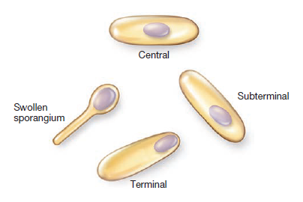

Slide 5
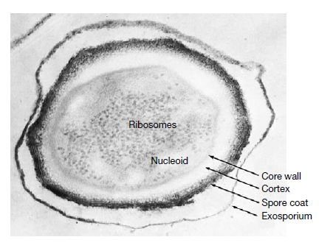
Structure of bacterial spore

Slide 6
The spore often is surrounded by a thin, delicate
covering called the exosporium
A spore coat lies beneath the exosporium, is composed of several protein layers, and may
be fairly thick
It is impermeable to many toxic molecules and is
responsible for the spore’s resistance to chemicals.
The coat also is thought to contain enzymes that are involved in germination

Slide 7
The cortex, which may occupy as much as half the spore volume, rests beneath the spore coat
It is made of a peptidoglycan that is less cross-linked than that in vegetative cells
The spore cell wall (or core wall) is inside the cortex and surrounds the protoplast or spore core
The core has normal cell structures such as ribosomes and a nucleoid, but is metabolically inactive
As much as 15% of the spore’s dry weight consists of dipicolinic acid complexed with calcium ions which is located in the core

Slide 8
Why spores are highly resistant
15% of the spore’s dry weight consists of dipicolinic acid complexed with calcium ions which is located in the core play important role in heat resistance
Calcium does aid in resistance to wet heat, oxidizing agents, and sometimes dry heat
Calcium-dipicolinate stabilizes the spore’s nucleic acids
In addition, specialized small, acid-soluble DNA-binding proteins (SASPs), are found in the endospore
They saturate spore DNA and protect it from heat, radiation, dessication, and chemicals.
Dehydration of the protoplast appears to be very important in heat resistance.
The cortex may osmotically remove water from the protoplast, thereby protecting it from both heat and radiation damage.
The spore coat also seems to protect against enzymes and chemicals such as hydrogen peroxide.
Core also contatin DNA repairing enzymes

Slide 9
Sporogenesis or sporulation
Normally commences when growth ceases due to lack of
nutrients
It is a complex process and may be divided into seven stages
Stage I An axial filament of nuclear material forms
Stage II inward folding of the cell membrane to enclose part of the DNA and produce the forespore septum
Stage (III) The membrane continues to grow and engulfs the immatureendospore in a second membrane
Stage IV Next, cortex is laid down in the space between the two membranes, and both calcium and dipicolinic acid are accumulated
Stage V Protein coats then are formed around the cortex
Stage VI maturation of the endospore occurs
Stage VII Finally, lytic enzymes destroy the sporangium releasing the spore

Slide 10
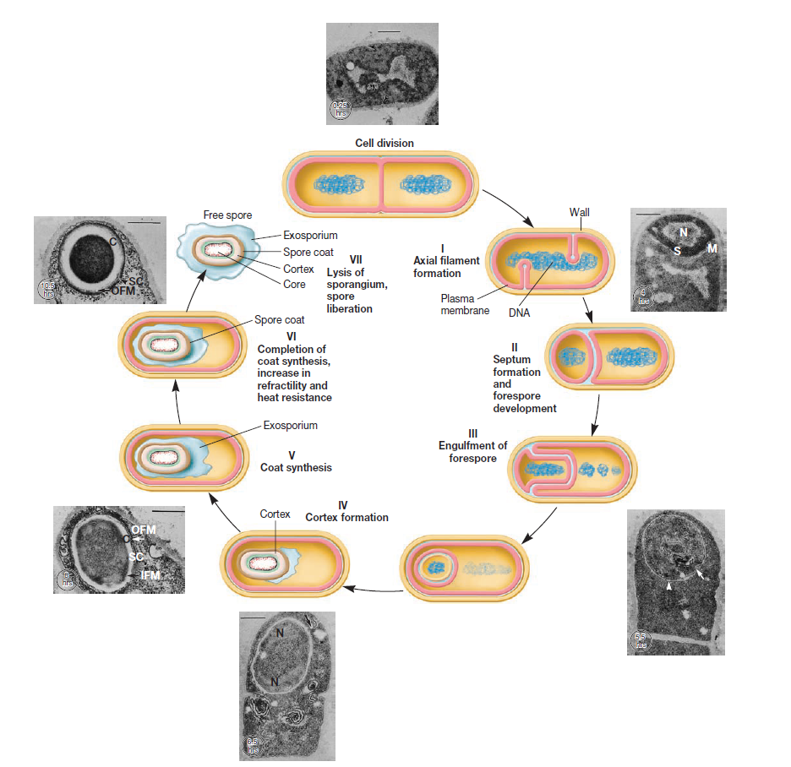
Sporulation or sporogenesis

Slide 11
Spore germination
The transformation of dormant spores into active vegetative cells.
It occurs in three stages: (1) activation, (2) germination, and (3) outgrowth
Often a spore will not germinate successfully, even in a nutrient-rich medium, unless it has been activated
Activation is a process that prepares spores for germination and usually results from treatments like heating.
Germination, the breaking of the spore’s dormant state
This process is characterized by spore swelling, rupture or absorption of the spore coat, loss of resistance to heat and other stresses, loss of refractility, release of spore components, and increase in metabolic activity.
Many normal metabolites or nutrients (e.g., amino acids and sugars)
can trigger germination after activation.
outgrowth. The spore protoplast makes new components, emerges from the remains of the spore coat, and develops again into an active bacterium.

